Slide 1
Day8
Collection FrameWork - First Session, Functional Programming

Slide 2
Boxing,Unboxing
Boxing, Unboxing
The automatic conversion of primitive data types into its equivalent Wrapper type is known as boxing and opposite operation is known as unboxing.
Wrapper classes

Slide 3
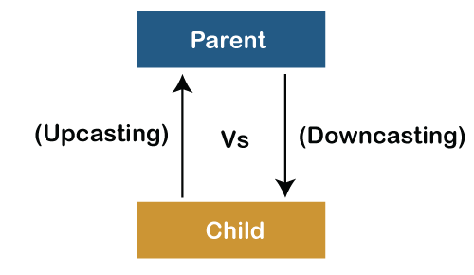
Parent and Sub class UpCasting and Downcasting
Machine machine1 declaration→ Name list of Machine’s fields, functions, default values
New Camera() → Container with camera fields and function program execution

Slide 4
JDK vs JRE vs JVM
Compile time
Run time

Slide 5
Wrapper Classes
Wrapper classes provide a way to use primitive data types (int, boolean, etc..) as object

Slide 6
Wrapper Class
Primitive Data Type | Wrapper Class
byte | Byte
short | Short
int | Integer
long | Long
float | Float
double | Double
boolean | Boolean
char | Character

Slide 7
Wrapper
ArrayList<int> myNumbers = new ArrayList<int>(); // Invalid
ArrayList<Integer> myNumbers = new ArrayList<Integer>(); // Valid

Slide 8
How to create Wrapper?
public class Main {
public static void main(String[] args) {
Integer myInt = 5; Double myDouble = 5.99; Character myChar = 'A'; System.out.println(myInt); System.out.println(myDouble); System.out.println(myChar); } }

Slide 9
Methods on Wrapper
intValue(), byteValue(), shortValue(), longValue(), floatValue(), doubleValue(), charValue(), booleanValue().
public class Main { public static void main(String[] args) { Integer myInt = 5; Double myDouble = 5.99; Character myChar = 'A'; System.out.println(myInt.intValue()); System.out.println(myDouble.doubleValue()); System.out.println(myChar.charValue()); } }

Slide 10
toString()
Integer myInt = 100;
String myString = myInt.toString();

Slide 11
Generics
Generics are features of the Java programming language that allow programmers to write parameterized code. They were originally created to address some problems with collections. Thus the term generics-collections is usually used together today

Slide 12
Generics
Add & Get
listNames.add("Peter")et method
String name2 = (String) listNames.get(1);
the cast to String is needed because the get() method returns an object of type Object.
What’s the issue? java.lang.ClassCastException: java.util.Date cannot be cast to java.lang.String

Slide 13
Generics
2. Why Use Generics?
Due to the demand of safer code, generics were added to the Java programming language. Indeed, it adds stability to the code, as potential bugs can be detected at compile time.
Here are the benefits of using generics:
Stronger type checks at compile time:
As you can see in the above examples, generics guarantee that there’s no wrong types added to the collections. Stronger type checking makes the code more readable:

Slide 14
Generics
2. Why Use Generics?
Due to the demand of safer code, generics were added to the Java programming language. Indeed, it adds stability to the code, as potential bugs can be detected at compile time.
Here are the benefits of using generics:
Stronger type checks at compile time:
As you can see in the above examples, generics guarantee that there’s no wrong types added to the collections. Stronger type checking makes the code more readable:

Slide 15
Generics
To master the Java programming language, you should able to understand and apply generics effectively into your daily coding. Here are my recommendations for learning generics:
The Java Tutorials Trail - Generics (Updated):this is official document published by Oracle, thus highly recommended. It explains the concepts like generic types, raw types, bounded type parameters, wildcards etc.
Notes:
type erasure

Slide 16
Generics
Elimination of casts:
As you can see in the above examples, we don’t have to use casts when taking elements out of a collection:
String name2 = listNames.get(1);
This makes the code simpler and more readable. Let’s look at another example.
Below is the code snippet to iterate over a List collection without using generics:

Slide 17
Generics
Note that all the interfaces and classes in the Java Collections Framework are parameterized like this, e.g. Set<E>, Queue<E>, Map<K, V>, ArrayList<E>, HashSet<E>
Code:
public interface List<E> extends Collection<E> {
boolean add(E e);
E get(int index);
}
Notes:
write parameterized methods like that, for the sake of readability, safety and reusability.

Slide 18
Collections
List Interface
Abstract List Class
Abstract Sequential List Class
Array List
Vector Class
Stack Class
LinkedList Class
Queue Interface
Blocking Queue Interface
AbstractQueue Class
PriorityQueue Class
PriorityBlockingQueue Class
ConcurrentLinkedQueue Class
ArrayBlockingQueue Class
DelayQueue Class
LinkedBlockingQueue Class
LinkedTransferQueue
Notes:
https://www.codejava.net/java-core/collections/java-list-collection-tutorial-and-examples

Slide 19
Collections
Deque Interface
BlockingDeque Interface
ConcurrentLinkedDeque Class
ArrayDeque Class
Set Interface
Abstract Set Class
CopyOnWriteArraySet Class
EnumSet Class
ConcurrentHashMap Class
HashSet Class
LinkedHashSet Class

Slide 20
Collections
SortedSet Interface
NavigableSet Interface
TreeSet
ConcurrentSkipListSet Class
Map Interface
SortedMap Interface
NavigableMap Interface
ConcurrentMap Interface
TreeMap Class
AbstractMap Class
ConcurrentHashMap Class
EnumMap Class
HashMap Class
IdentityHashMap Class
LinkedHashMap Class
HashTable Class
Properties Class

Slide 21
Collections
What is a Framework?
Java Collections Framework is a set of reusable data structures and algorithms which are designed to free programmers from implementing data structures themselves so that they can focus on business logics.

Slide 22
What is a Collection?
In terms of programming, a collection is a data structure that holds a set of objects in a specific manner. It looks like arrays but collections are more advanced and more flexible. An array simply stores a fixed number of objects, whereas a collection stores objects dynamically, i.e. you can add or remove objects as you wish.
A collection also provides useful operations such as adding, removing, retrieving objects.

Slide 23
Collection
Advantages of the Collection Framework:
Consistent API
Reduces programming effort
Increases program speed and quality

Slide 24
Collection
Advantages of the Collection Framework:
Consistent API
Reduces programming effort
Increases program speed and quality

Slide 25
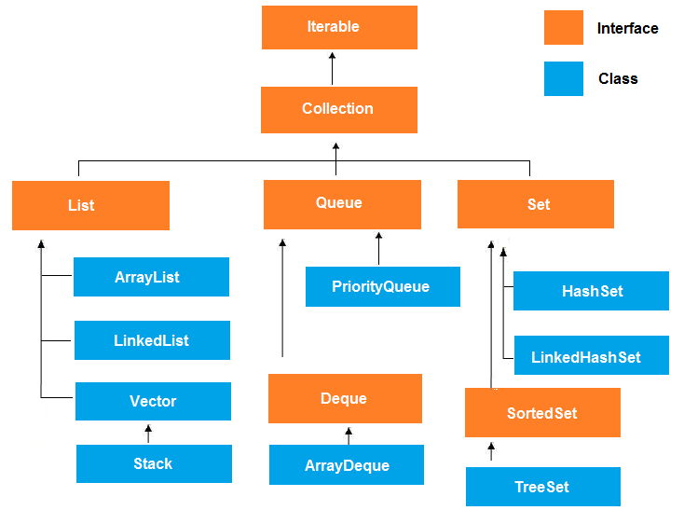
Collection – java.util

Slide 26
How to Use Java Collections Framework?
Example of List collection
List<Integer> numbers = new ArrayList<>();
numbers.add(1);
numbers.add(5);

Slide 27
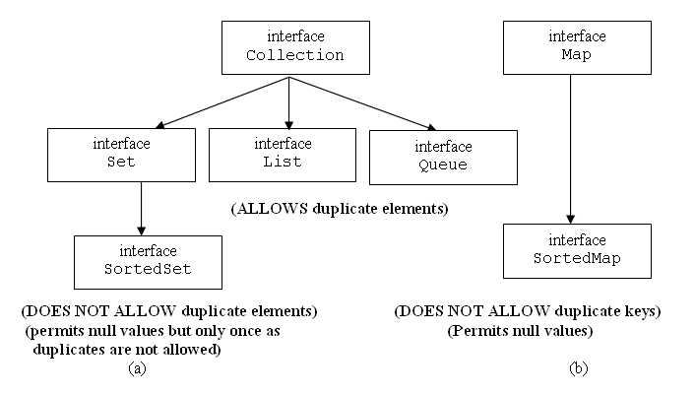
Collection

Slide 28
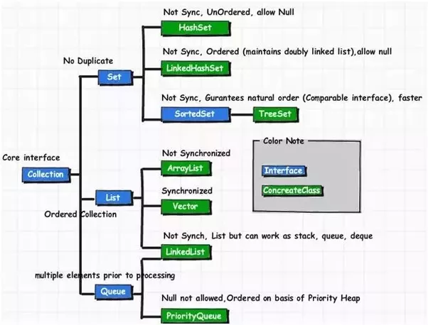
Collection

Slide 29
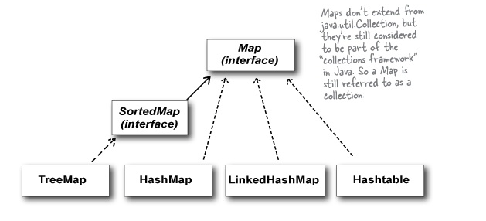
Map

Slide 30
1. Overview of List Collection
2. Creating a new list
3. Basic List operations
4. Iterating over elements in a list
5. Searching for an element in a list
6. Sorting a list
7. Copying elements from one list into another
8. Shuffling elements in a list
9. Reversing elements in a list
10. Extracting a portion of a list
11. Converting between Lists and arrays
12. List to Stream
13. Concurrent lists

Slide 31
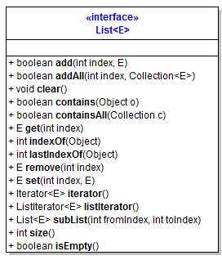
List

Slide 32
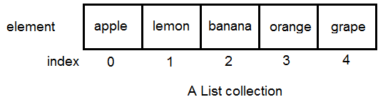
List
Overview of List collection
Fundamental and widely-used
Order: insertion

Slide 33
List
A list can store objects of any types.
Primitive types are automatically converted to corresponding wrapper types, e.g. integer numbers are converted to Integer objects.
It allows null and duplicate elements, and orders them by their insertion order (index).

Slide 34
List
ArrayList
An implementation that stores elements in a backing array.
For fast, random access of the elements.
LinkedList
An implementation that stores elements in a doubly-linked list data structure
fast adding and removing elements at the end of the list is required.

Slide 35
FP
A rule specifying how to construct outputs from inputs

Slide 36
Functional Programming
Functions as first class objects
Pure functions
Higher order functions
Pure functional programming has a set of rules to follow too:
No state
No side effects
Immutable variables
Favour recursion over looping

Slide 37

FP

Slide 38
FP in Java
In Java, methods are not first class objects.
closest we get is Java Lambda Expressions
You can create an "instance" of a function, as have a variable reference that function instance, just like a reference to a String, Map or any other object. Functions can also be passed as parameters to other functions.
Haskell
(\x y -> x + y)
Kotlin
val pred = { x: Int -> x % 2 == 0 } val result = pred(4) // true
JS
const adder = x => y => x + y; add5 = adder(5); add5(1) == 6

Slide 39
Pure Functions
A function is a pure function if:
The execution of the function has no side effects.
The return value of the function depends only on the input parameters passed to the function

Slide 40
Pure vs Non-pure (state)
public class ObjectWithPureFunction{
public int sum(int a, int b) {
return a + b; }
}
public class ObjectWithNonPureFunction{
private int value = 0;
public int add(int nextValue) {
this.value += nextValue;
return this.value; }
}

Slide 41
Higher Order Functions
A function is a higher order function if at least one of the following conditions are met:
The function takes one or more functions as parameters.
The function returns another function as result.

Slide 42
Interface
public class HigherOrderFunctionClass {
public <T> IFactory<T> createFactory(IProducer<T> producer, IConfigurator<T> configurator)
{
return () -> {
T instance = producer.produce(); configurator.configure(instance);
return instance;
}
}
}

Slide 43
No State
public class Calculator {
public int sum(int a, int b) {
return a + b;
}
}
E.G of External State:
public class Calculator {
private int initVal = 5;
public int sum(int a) {
return initVal + a;
}
} Adv: No Side effects

Slide 44
Rules
Immutable Variables
Favour Recursion Over Looping
Referential Transparency – Same o/p irrespective of times of calling with same I/P
Currying.

Slide 45
Functional Programming - Currying
Currying - Named after Haskell Curry.
currying is the technique of converting a function that takes multiple arguments into a sequence of functions that each takes a single argument. For example, currying a function {\displaystyle f} that takes three arguments creates three functions:
{\displaystyle {\begin{aligned}x=f(a,b,c)&{\text{ becomes:}}\\h=g(a)\\i=h(b)\\x=i(c)\\{\text{or called in sequence:}}\\x=g(a)(b)(c)\end{aligned}}}

Slide 46
FP
Declarative/Imperative?
Declarative as like HTML -> say what to declare
Impertive -> Say how to do step by step

Slide 47
Functional Interface
Only one abstract method(SAM) + default+static Methods
Create object with Lambda statements.

